Slide 2
Higher Level Exam
Higher Level Paper is a 3 hour exam and is worth 400 marks
Three Sections
Students will answer questions from all three sections

Slide 3
Section 1- Short Questions
Total Marks: 80 marks
Questions to be attempted: 8
Total number of Questions: 10
Marks per Question: 10 marks
Format short answer questions covering the entire syllabus
Percentage of total examination: 20%

Slide 4
Section 2- Analysed Business Question
Total Marks: 80 marks
Total number of Questions: 1
Form at Applied Business Question based on certain units of the course which will alternate yearly.
Percentage of total examination :20%

Slide 5
Section 3- Long Questions
Total Marks: 240 marks
Questions to be attempted: 4 (restrictions on options)
Total number of Questions: 7
Marks per Question: 60 marks
Format Variety of questioning techniques
Percentage of total examination: 60%

Slide 6
Ordinary Level Exam
Ordinary Level Paper is a 2 ½ hour exam and worth 400 marks
10 Short Questions (100 marks)
4 Long Questions (300 marks)

Slide 7
Structure of syllabus
The syllabus is broken down into three sections:
People in Business, Enterprise, and Business Environment
Section A: People in Business
(Unit 1) Introduction to people in business
People and their relationships in business
Conflicting interests and how they are resolved

Slide 8
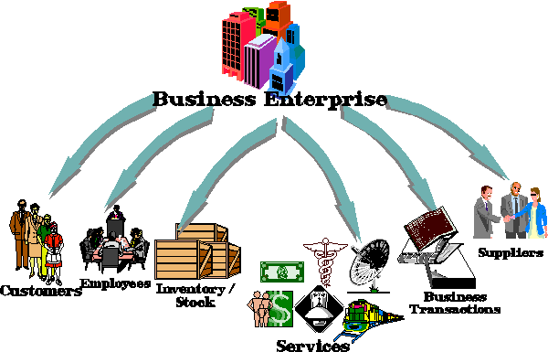
Structure of syllabus
Section B Enterprise
(Unit 2) Enterprise
Introduction and definition of enterprise
Entrepreneurs and enterprise skills
(Unit 3) Managing 1
Introduction and definition of management
Managers and management skills
Management activities

Slide 9
Structure of syllabus
(Unit 4) Managing 2
Household and business manager
Human resource management
Changing role of management
Monitoring the business
(Unit 5) Business in action
Identifying opportunities
Marketing
Getting started
Expansion

Slide 10
Structure of syllabus
(Unit 6) Domestic Environment
Categories of industry
Business and the economy
Government and business
Social responsibilities of business
(Unit 7) International Environment
Introduction to the international trading environment
European Union
International business

Slide 11
