Slide 1
Demand and Supply
The market price for products and services is affected by the demand and supply of products and services
If there is a high supply and low demand- what will happen to prices?
If there is a low supply and high demand- what will happen to prices?

Slide 2
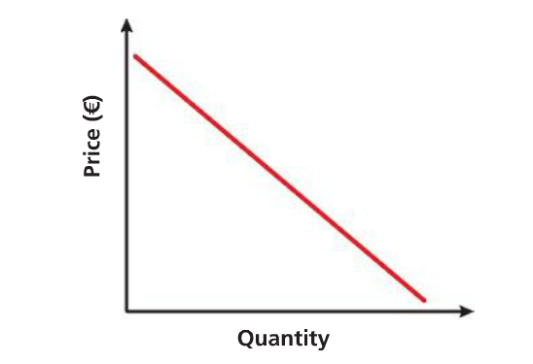
The Demand Curve
The relationship between demand and price can be shown on a demand curve. This will show that generally the higher the price, the lower the demand
The curve will have a downward slope.

Slide 3
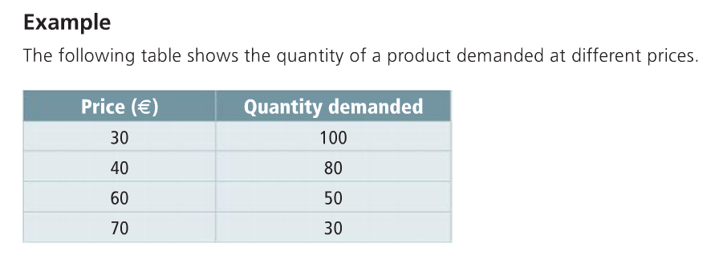
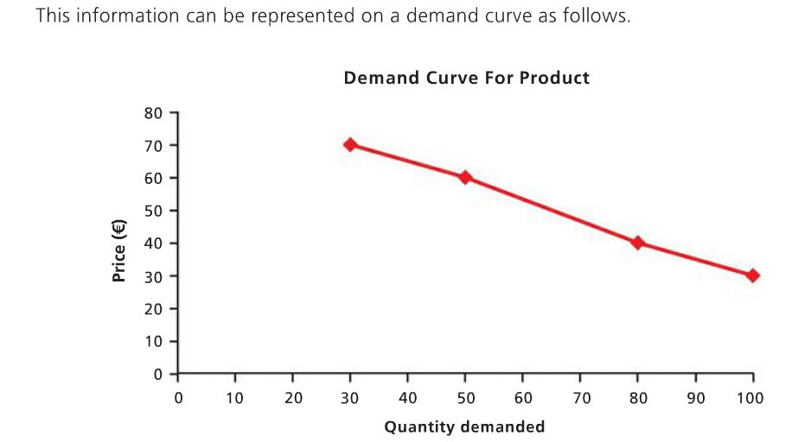

Slide 4
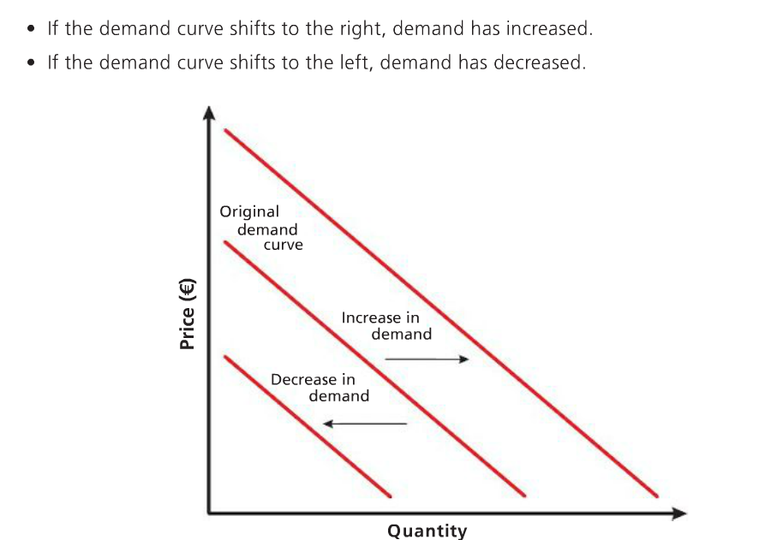

Slide 5
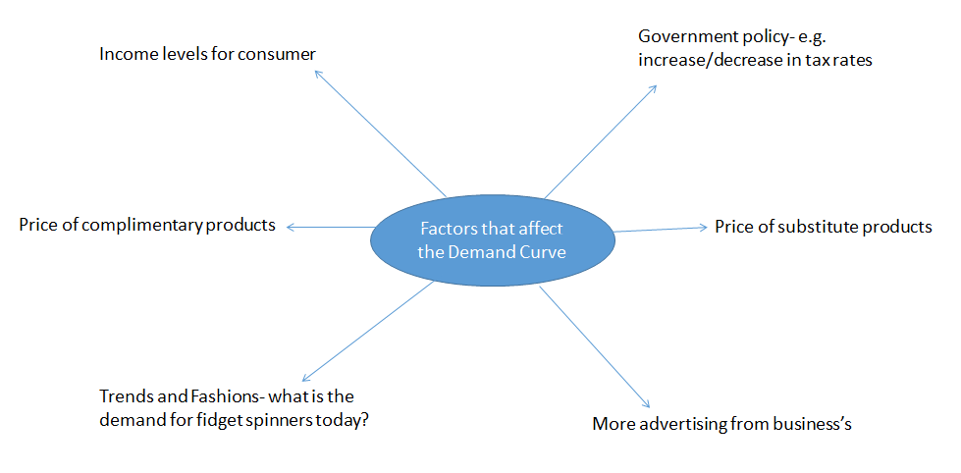
Factors that affect Demand

Slide 6
Exceptions to the Law of Demand
If a product is addictive, like cigarettes
If a product is superior against competitors
If there is a monopoly on products and consumers have no alternatives
If it must be purchased, such as medication for illnesses like diabetes

Slide 7
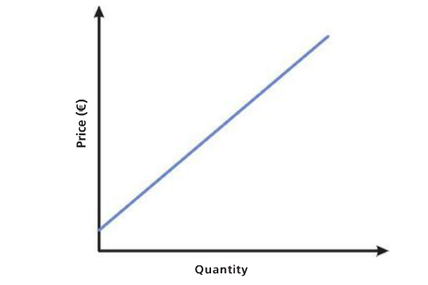
The Supply Curve
The relationship between supply and price can be shown on a supply curve. This will show that the higher the price, the higher the supply will be
This curve will have an upward slope

Slide 8
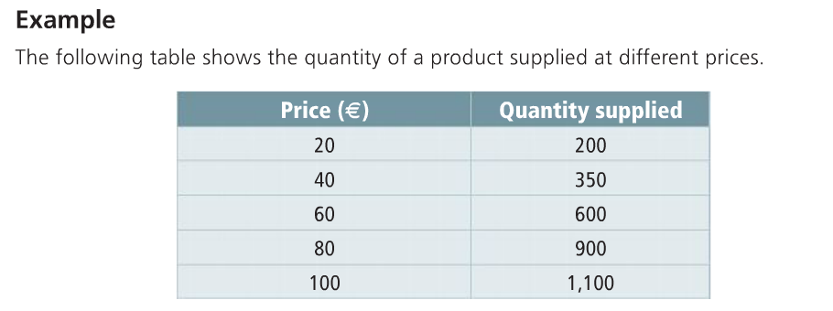
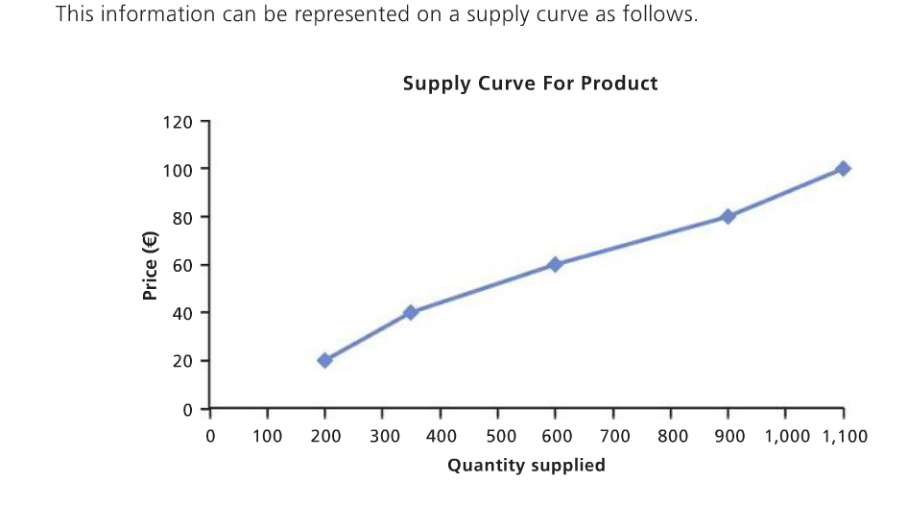

Slide 9
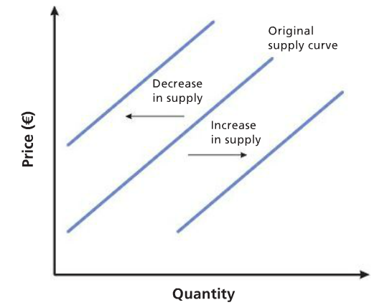

Slide 10
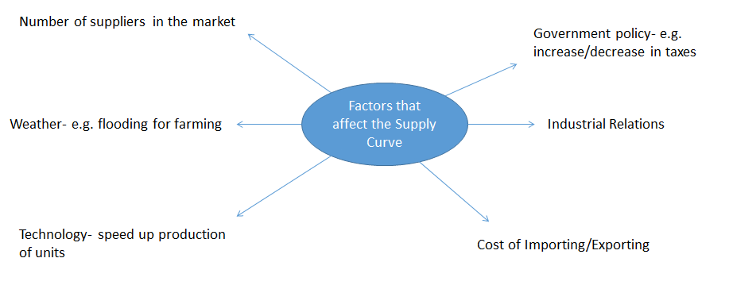
Factors that affect Supply

Slide 11
Exceptions to the Law of Supply
When goods are in fashion, prices can be high, and when not in fashion the prices will be low- e.g. calendars, toys
If a supplier expects prices to increase in the future, they may keep supplies back until the prices rise- e.g. oil

Slide 12
Substitute and Complimentary Goods
Substitute goods are two goods that can be used in place of one another, for example, Dominos and Pizza Hut.
By contrast, complementary goods are those that are used with each other. For example, pancakes and maple syrup.

Slide 13
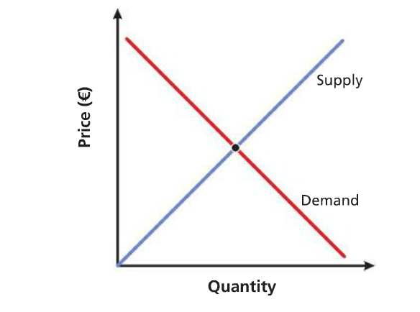
Market Equilibrium
This is the point at which supply and demand intersect, in other words the quantity demanded is the same as the quantity demanded

Slide 14
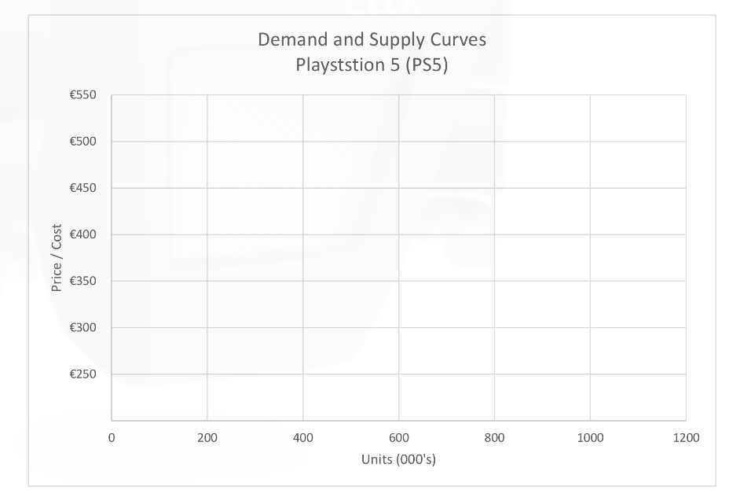
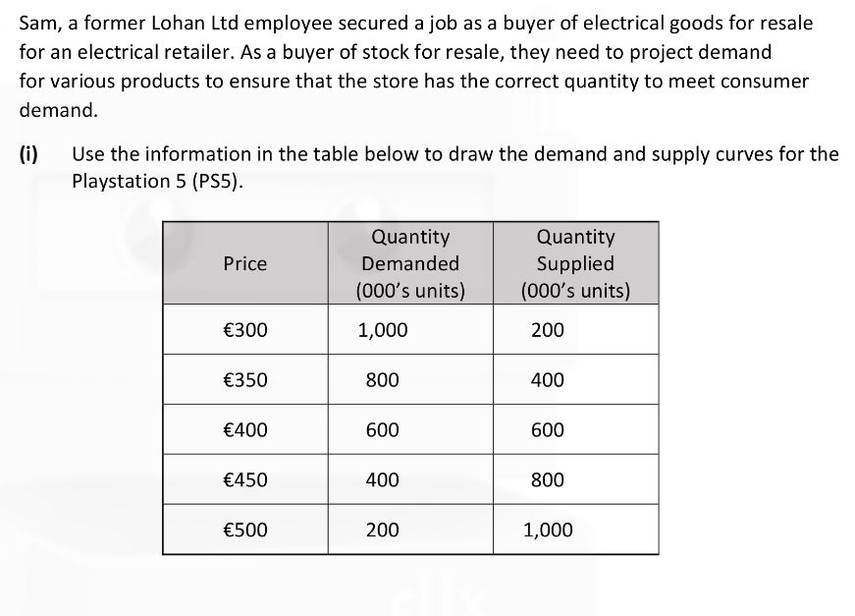
Drawing the Market Equilibrium 2022 Question

Slide 15
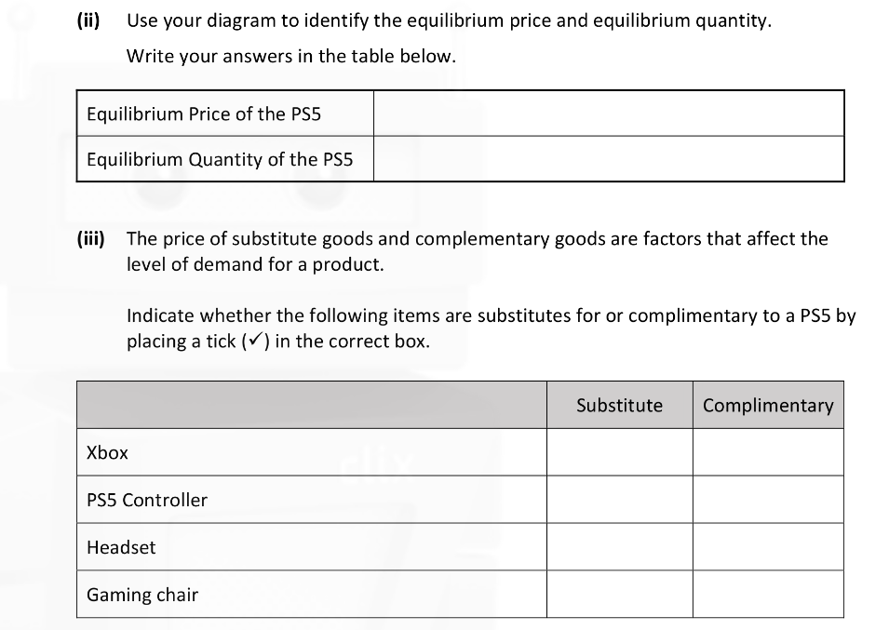
Drawing the Market Equilibrium 2022 Question

