Slide 1
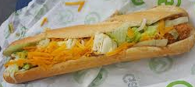
Consumers and their choices
A consumer is an individual who buys a good or service for their own personal use. Example would be buying tickets for Electric Picnic or going to the shop and buying a sandwich for yourself
When it comes to consumers and their choices, it is expected that they act rationally- in other words they make correct choices and will always go for the option of better value

Slide 2
Characteristics of Economic Goods for Consumers
Price
It must command a price. The good must be scarce in relation to the demand for it , i.e. there is not enough of it to satisfy the demand of all those who want it. E.g. Fresh air is not scarce (plentiful in supply) so people are not prepared to pay for it. However, people will pay over the odds for tickets to the Champions League final or Longitude
Utility
The good must provide the consumer with some feeling of satisfaction. Consumers will not demand something that doesn’t provide satisfaction. E.g. You are not going to pay your business teacher to open the school on Saturday for you to come to class

Slide 3
Characteristics of Economic Goods for Consumers
Transferable
Ownership or benefit is capable of being given from one person to another. E.g. You can sell someone a car but you cannot sell them something that will make them younger or healthier

Slide 4
Utility
We have just learned that Utility is the amount of benefit/satisfaction you get from using a good or service. Consumers will seek to spend their income in a way that will lead to maximum utility for them
BUT- Consumers have LIMITED INCOMES
Their income is not large enough to satisfy all their needs and wants. Therefore, the consumer is forced to make choices on the products and services that they will buy- there will be an opportunity cost on products and services

Slide 5
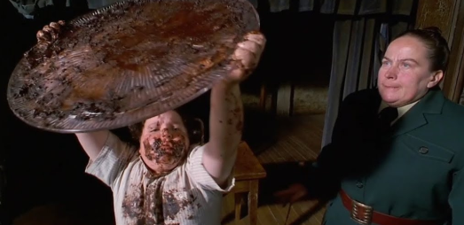
Measuring Utility
Think back to Matilda and the scene when Bruce is forced to eat the cake by Ms Trunchbull- how did Bruce feel as he ate more and more cake? Would it be fair to say his utility increased or decreased at different stages?
https://youtu.be/EOQeU_6vbeg

Slide 6
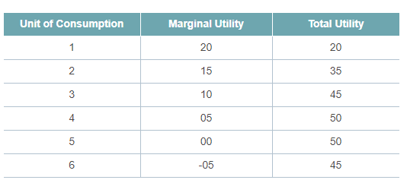
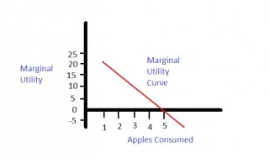
And so with Utility, we are able to show this data using a table and graph
Law of Diminishing Marginal Activity for eating apples.
1. What do you notice about the marginal utility in this picture?
2. Where should the person stop eating apples?

Slide 7
Could we have a volunteer to conduct a social experiment on utility in the classroom?

Slide 8
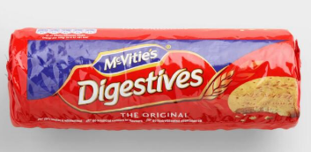
Recording Utility
In class, we are going to conduct a social experiment using biscuits. We will hope that as each biscuit is consumed, this will effect the overall utility of the student involved.

Slide 9
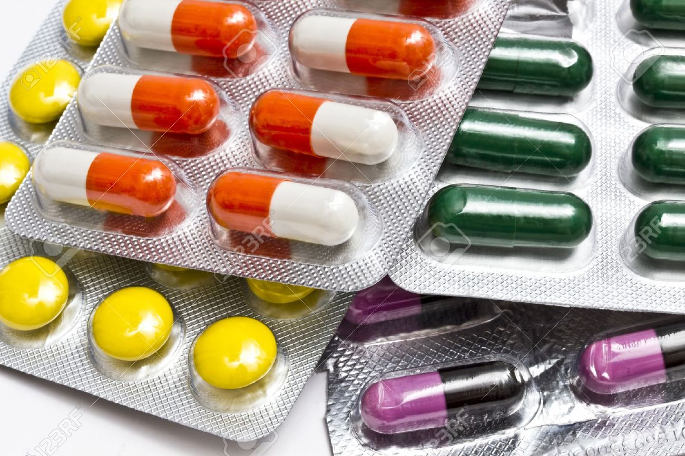
Items not affected by Diminishing Marginal Utility
Cigarettes
People who are addicted to cigarettes will continue to smoke. Each cigarette will bring the same marginal utility
Medicine
Every dose is just as important as the last

Slide 10
Experiment
Take any product/service over the next week and record your utility over that day.

